Slide 1
Financial Exploitation of the Elderly in Tennessee
Cassie Stinson & Kim Potts
Office of Research and Education Accountability (OREA)
10.13.2021

Slide 2
Introductions
The Office of Research and Education Accountability (OREA) provides the General Assembly with objective and accurate research, evaluation, and analysis.
Our reports originate from:
requests by state legislators;
state law; or
internally generated research proposals.

Slide 3
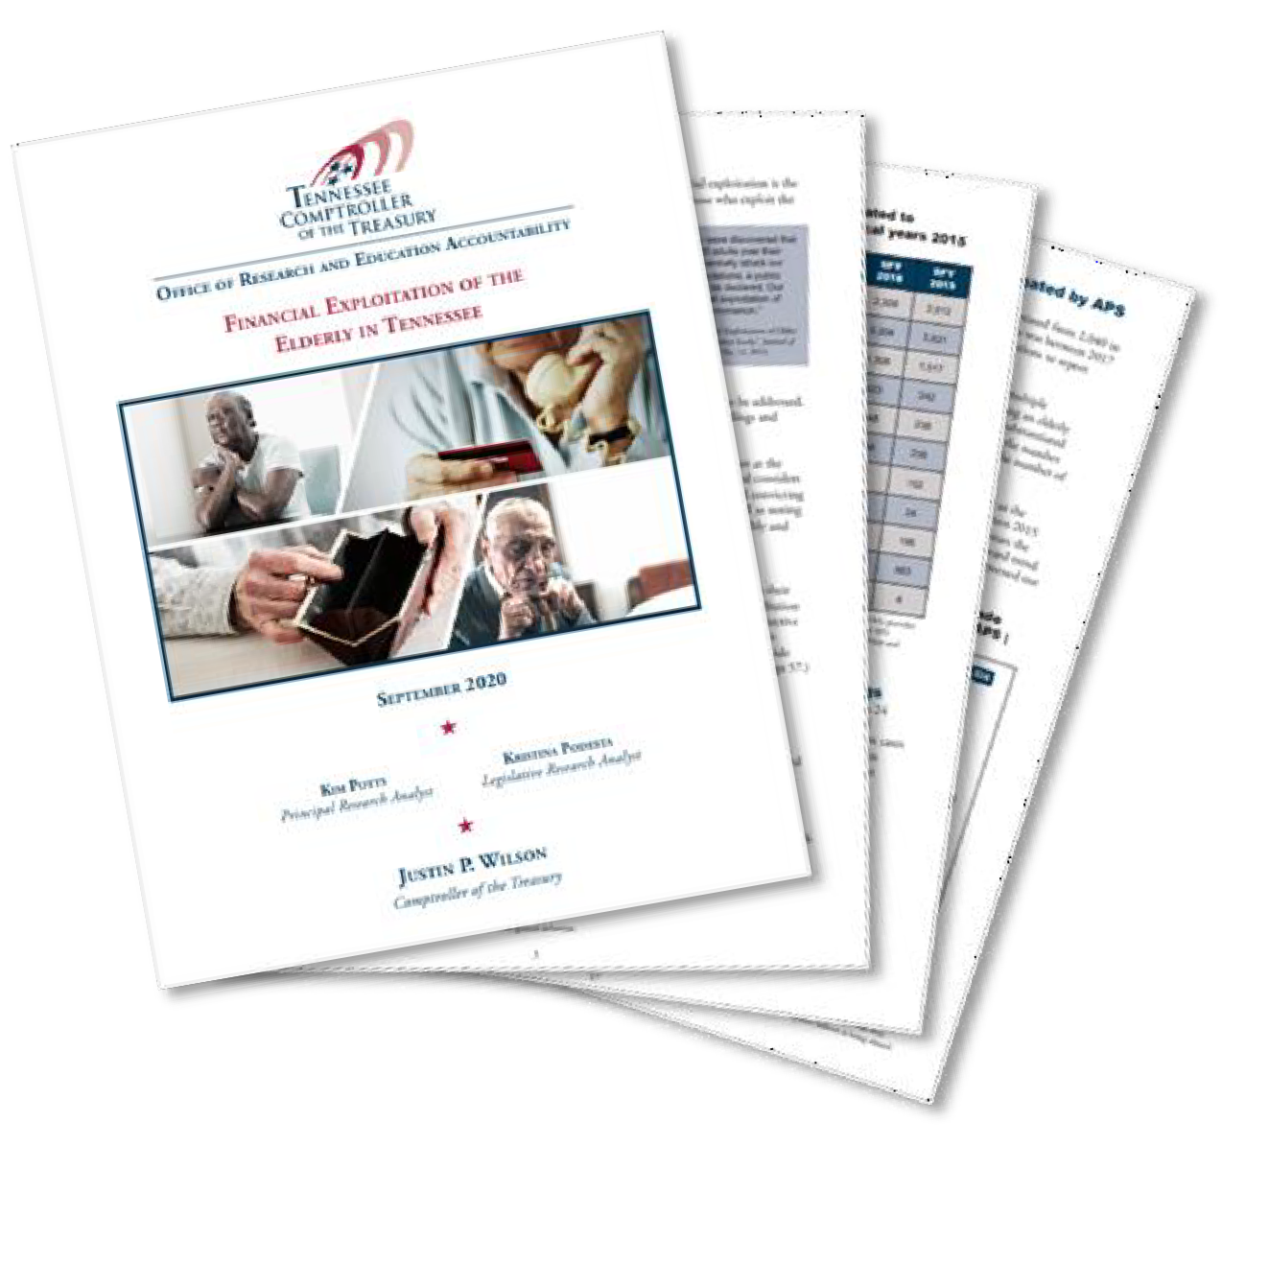
About our report
We developed this report at the request of legislators.
The full report:
summarizes research
considers Tennessee’s approach
addresses stakeholders’ views about potential gaps in the system
We included five overarching conclusions and nine policy options for consideration.

Slide 4
Overview
Elder financial exploitation is the wrongful or unauthorized use of the assets, funds, or property of elderly individuals.
The agency most closely associated with this issue is the Adult Protective Services (APS) program in the Department of Human Services.
“If a new disease entity were discovered that afflicted nearly one in 20 adults over their older lifetimes and differentially struck our most vulnerable subpopulations, a public health crisis would likely be declared. Our data suggest that financial exploitation of older adults is such a phenomenon.”
Janey C. Peterson, et al., “Financial Exploitation of Older Adults: A Population-Based Prevalence Study,” Journal of General Internal Medicine, Vol. 29, No. 12, 2014.

Slide 5
The Tennessee General Assembly strengthened state laws
Elderly and Vulnerable Adult Protection Act of 2018
requires APS to provide copies of investigative files to district attorneys general
Elderly and Vulnerable Adult Protection Act (2017)
creates financial exploitation of elderly or vulnerable adults offense
Elderly and Vulnerable Adult Financial Exploitation Prevention Act (2017) and Senior Financial Protection and Securities Modernization Act (2017)
authorizes financial institutions, broker-dealers, and investment advisors to report suspected financial exploitation
gives the Department of Commerce and Insurance the authority to deny, revoke, or suspend licenses of those who commit acts of financial exploitation
Public Chapter 1006 (2016)
requires district attorneys to create Vulnerable Adult Protective Investigative Teams

Slide 6
Conclusion 1:
Many said that APS criteria is too narrow
APS criteria for investigating a report of financial exploitation:
alleged perpetrator must be a caretaker
must involve government funds
based on a 1978 state law
State law defines financial
exploitation as “the improper use by a caretaker of funds that have been paid by a governmental agency to an adult or to the caretaker for the
use or care of the adult.”

Slide 7
Conclusion 1:
Many said that APS criteria is too narrow
Screened out for other reasons (e.g., did not involve a caretaker)
Did not involve government funds
Investigated reports
Fiscal year 2019
39%,
1,503
20%, | 41%,
756 | 1,565
0 500 1000 1500
2000
2500
3000
3500

Slide 8
Conclusion 1:
Many said that APS criteria is too narrow
Those who expressed concerns:
state legislators
TCAD
several District Attorneys in response to OREA questions
those interviewed by OREA throughout our research
In 2017, DHS analyzed the impact of expanding its criteria to include non-governmental funds
DHS estimated that 25 new positions would be needed
DHS estimated it would cost $2.2 million.
any other changes to APS criteria would require additional resources

Slide 9
Conclusion 2:
Current data limitations prevent accurate estimates
No statewide system to track elder financial abuse cases
This is problematic because
cases are shared between agencies
cases cannot be linked
it is not possible to get a unique count of cases

Slide 10
Conclusion 2:
Current data limitations prevent accurate estimates
Data available to OREA from state and local agencies
 | Reports | Investigations | Outcomes of investigations | Financial losses
APS | Yes | Yes | Yes | No
TBI Medicaid Fraud Control Division | Yes | No | No | No
Long-Term Care Ombudsman | Yes | Yes | No | No
Department of Commerce and Insurance | Yes | Yes | Yes | Yes
Financial Institutions (tracked by FinCEN*) | Yes | N/A | N/A^ | No
 | Investigations | Prosecutions | Outcomes of prosecutions | Financial losses
Local District Attorneys | No | 13 of 31 judicial districts | 10 of 31 judicial districts | 2 of 31 judicial districts~
Administrative Office of the Courts | No | Only some offenses* | Only some offenses | No

Slide 11
Conclusion 3:
Assessing the state’s patchwork approach proved difficult
Number of reports concerning elder financial exploitation made to APS, and numbers of allegations investigated and substantiated by APS | 2015-2019
3,824
─ Reports of financial exploitation
3,288
2,414
2,415
2,040
─ Investigated allegations
1,415
1,569
1,525
1,341
1,263
─ Substantiated
allegations
209
207
175
204
146
2015
2016
2017
2018
2019

Slide 12
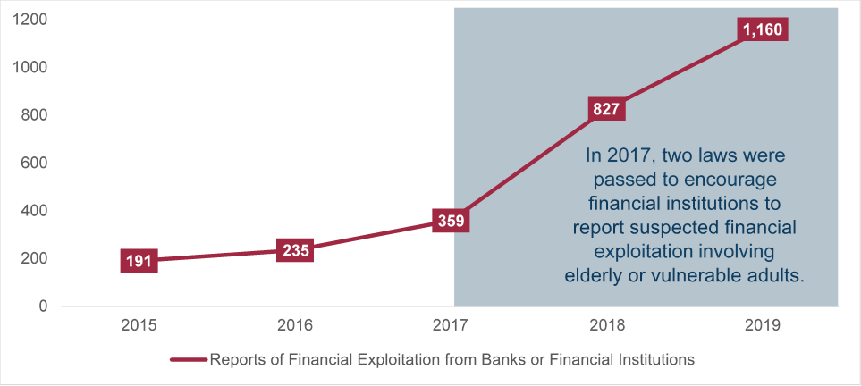
Conclusion 3:
Assessing the state’s patchwork approach proved difficult
Reports to Adult Protective Services of suspected financial exploitation from banks, credit unions, and other financial institutions

Slide 13
Conclusion 3:
Assessing the state’s patchwork approach proved difficult
Reports from financial institutions are more often screened out because:
financial institutions are less likely to know the relationship between the potential victim and perpetrator
financial institutions are also more likely to report online or via fax
less detailed than phone conversations
APS cannot reach the original reporter
APS is not always able to follow up on online or faxed reports

Slide 14
Conclusion 3:
Assessing the state’s patchwork approach proved difficult
Between 2015 and 2019:
number of reports forwarded to other entities increased
district attorneys received 50 times more reports from APS
the number of reports sent to local police nearly doubled
It is not possible to track cases shared between agencies
making it difficult to assess the current system to protect elderly adults

Slide 15
Conclusion 4:
Prosecutions are increasing, but a data system is needed
OREA requested the data from each judicial district:
ability to track case data was inconsistent
prosecutions are increasing
not everyone is familiar with new laws
A lack of data system impedes tracking of new laws
A previous attempt fell through
“There is simply no system in place that enables us to consistently and reliably gather important [court] data on almost any subject, including elder abuse.”
Jerry Estes, Former Executive Director of the
Tennessee District Attorney General’s Conference

Slide 16
Conclusion 5:
District attorneys indicate a need for staff
Financial exploitation cases are
complex,
challenging, and
resource intensive.
Some districts lack
expertise in tracking assets and forensic accounting,
criminal investigators, and
training.
“Manpower is the biggest lacking resource, particularly with financial exploitation cases, which can be tedious and time consuming. Some also require specialized skill and training, and most law enforcement officers are not trained
accountants.”
-Response from one of the judicial districts that responded to questions from OREA

Slide 17
Policy options for consideration
The General Assembly may wish to
expand APS criteria
create additional intake staff positions at APS
urge the federal government to allow state Medicaid Fraud Control Division to investigate Medicaid fraud outside of institutional settings
revise state law concerning the confidentiality of reporters to APS
fund additional staff positions for district attorneys general
fund and mandate improvements to data collection of elder abuse cases
create a statewide system
report the age of victims to the Administrative Office of the Courts
more detailed information in the annual reports about VAPITs

Slide 18
Policy options for consideration
Adult Protective Services may wish to
publish an annual report
create a guidebook for financial institutions
Organizations represented on the Elder Abuse Task Force could
use geographical analysis presented in OREA’s report to focus training and
awareness raising efforts

Slide 19
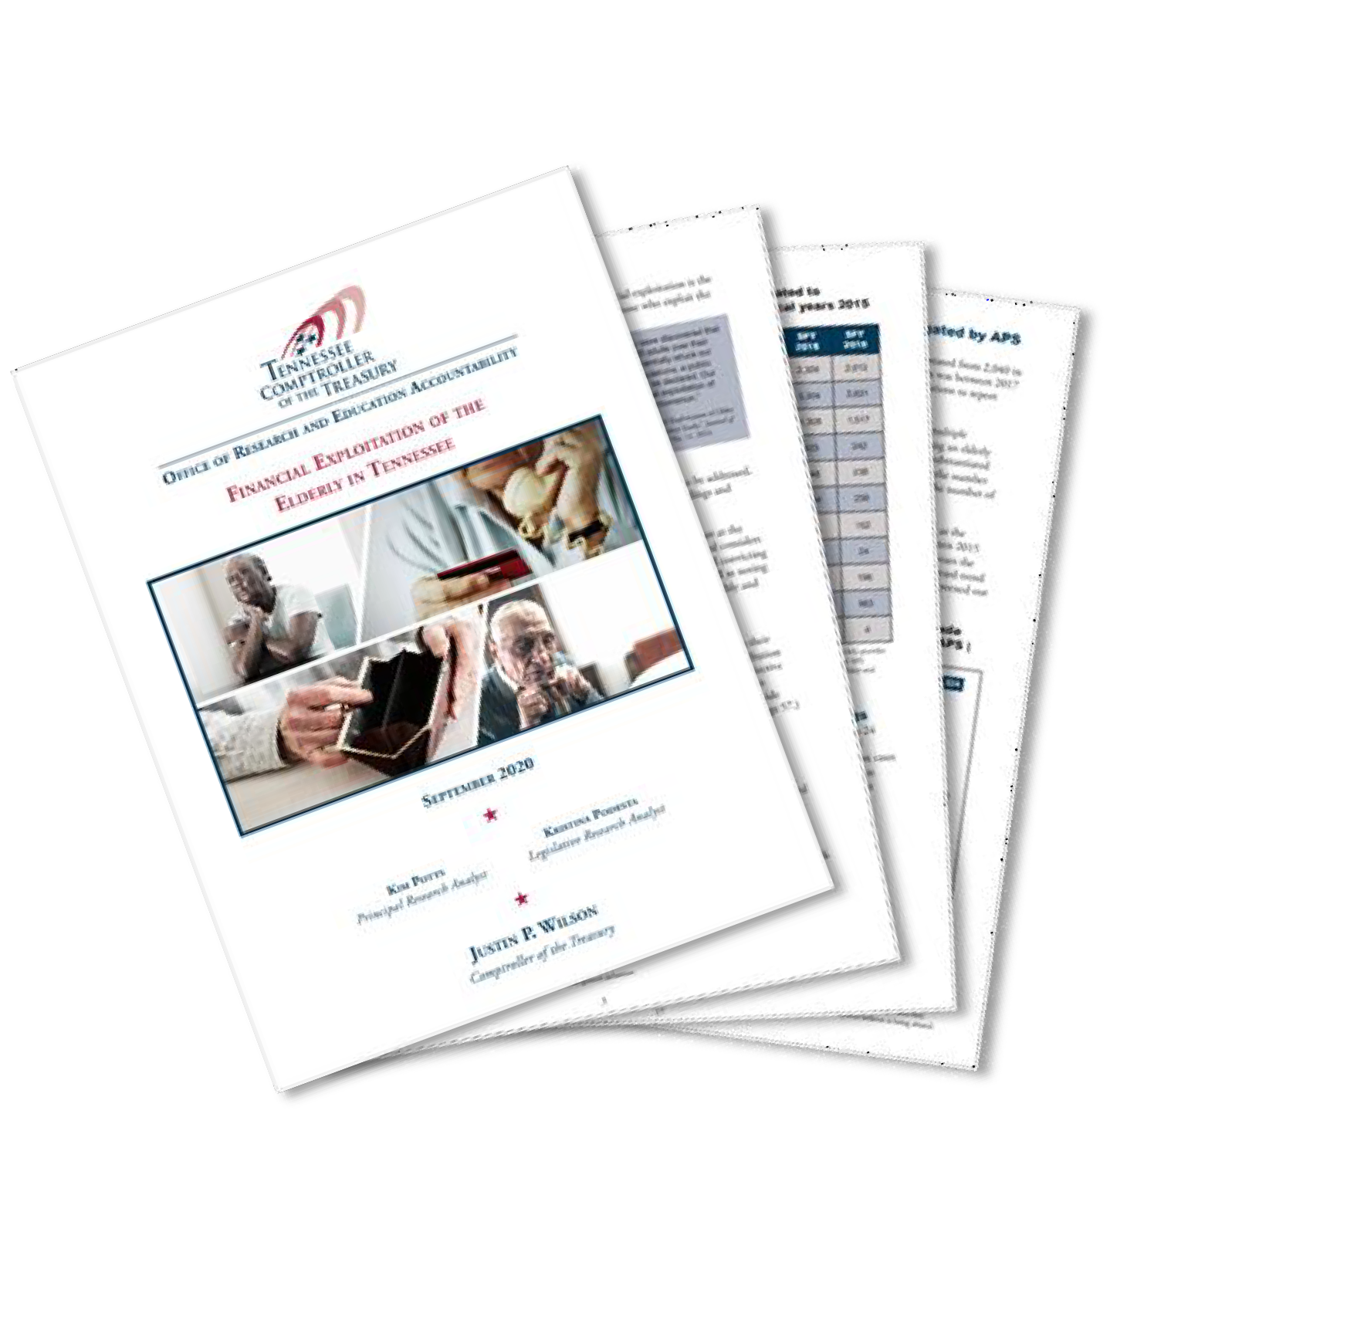
Thank you!
For our full report and executive summary, please see tncot.cc/orea

